Slide 1
Employee Attrition Problem (Solution)
For X Company

Slide 2
PROBLEM STATEMENT
Overview:
Company X which is trying to control attrition, There are two sets of data: “Existing employees” and “Employees who have left”. Use the Dataset to achieve the objective.
Objective:
What type of employees are leaving?
Determine which employees are prone to leave next.
Present your results in the presentation sheet’s presentation area.

Slide 3
METHODOLOGY/APPROACH
Observe
Understand
Analyze
Interpret
Solution

Slide 4
OBSERVATION
Going through the dataset to understand its distribution and shape, I found out that most of the dataset measures that are meant to be dependent variables of measures or dimensions are all independent of each other which makes it hard to get a correlation between the variables.

Slide 5
UNDERSTANDING
Base on the observation, no variable depends on the other, which means that all outcomes depends on their individual events, and each event has only but one parameter input.
Example:
OUTCOME EVENT PARAMETER
X*Promoted_Last_5yrs Promoted_Last_5yrs Employee
NOTE: Where X is an aggregation function

Slide 6
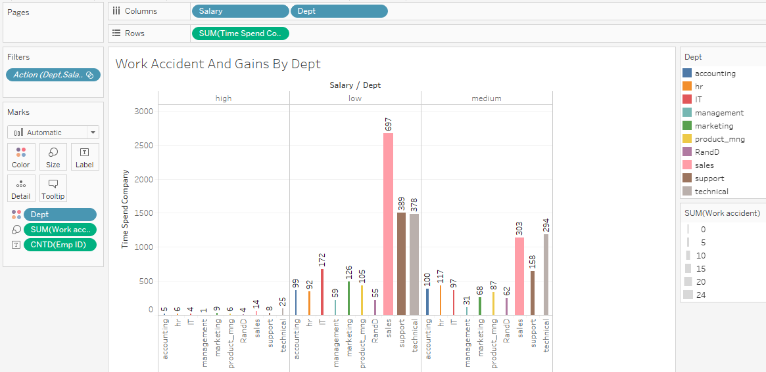
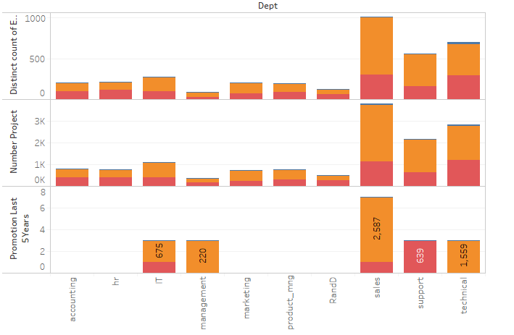
ANALYZE
Using visualization techniques to analyze the dataset in order to identify patterns and observe common trends within and out of the variables scope.

Slide 7
INTERPRET
From the analysis, it was a common trend that more privilege and appreciation is being given to employees of high income and more from the management department that contribute less to the growth of the company but rather holding high positions and sitting one place. The trend of “MONKEY DEY WORK BABOO DEY CHOP” Thereby disregarding the low income earners which are the strong hold of the company.

Slide 8
SOLUTION
From Objective:
What type of employees are leaving?
From my analysis and predictions, employees that are leaving the company are employees of low income that haven't been promoted for the last 5 years.
Determine which employees are prone to leave next.
Employees with high income from IT and Product_mng department that haven't been promoted for last 5 years are prone to leave next.

Slide 9
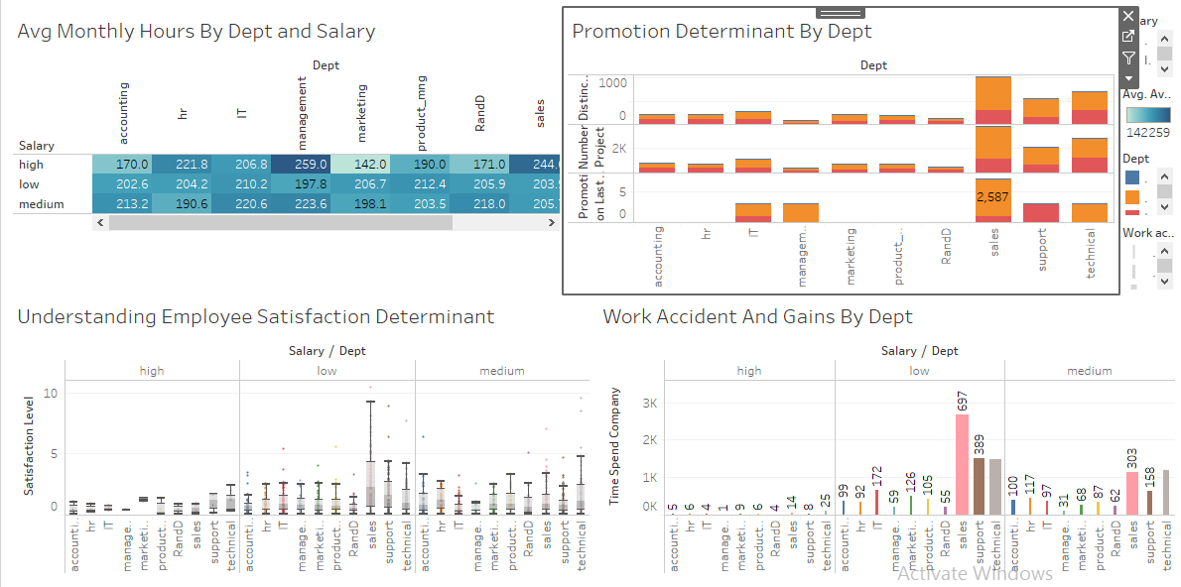
SOLUTION

Slide 10
SATISFACTORY SOLUTION
Let there be a measure for performance and reward accordingly
Create an independent measure of which promotion variable will depend on, this helps to regulate promotion processes within the company.
Once someone is promoted, let there be an increase in his/her income level.
Allocate award and titles by achievement and commitment.
Sanitize the Sale, Support and Technical department to reduce death incidents and reduce their allocated work.
Allocate more work to the high income earners to get them engaged in order to increase their satisfaction. Having no work to do is making them loose interest in their job.
Create an annual evaluation pipeline for all employees of all level

